Slide 1
Warehouse Scale Computers and other Message-Passing Multiprocessors.
Shrihari BH
2nd yr B.tech IT
KGiSL Institute of Technology

Slide 2
Warehouse Scale Computers (WSC)
WSC is a Cluster Comprised of tens of Thousands of Servers
Cluster System – Combination of Tow or More Individual Computer Systems Merged together
They have Independent Computer Systems with a Common Storage and the Systems work together
It Provides Power Full Application
A WSC can be used to provide internet services
Google – Search
Google Collab , Jupiter Notebook
You tube
Amazon
And Many More Application

Slide 3
Its is a Set of are Mounted within a Rack and Interconnected Using a Local Ethernet Cable (LAN) These Rack –Level Can Have Number of Uplink Connections to One or More Cluster – Level Ethernet Sitches

Slide 4
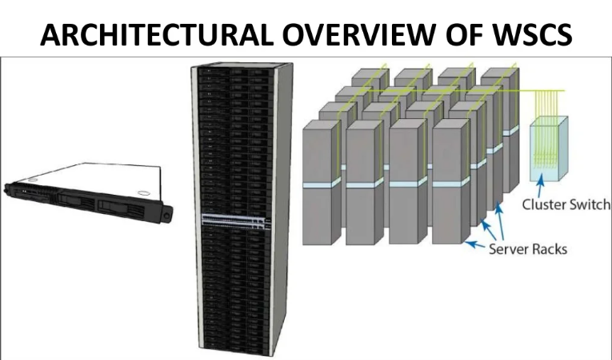

Slide 5
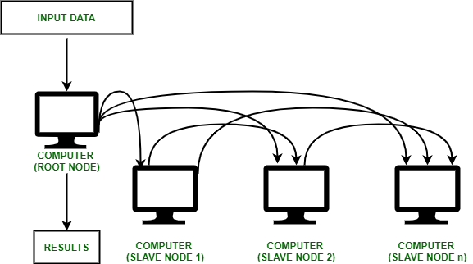
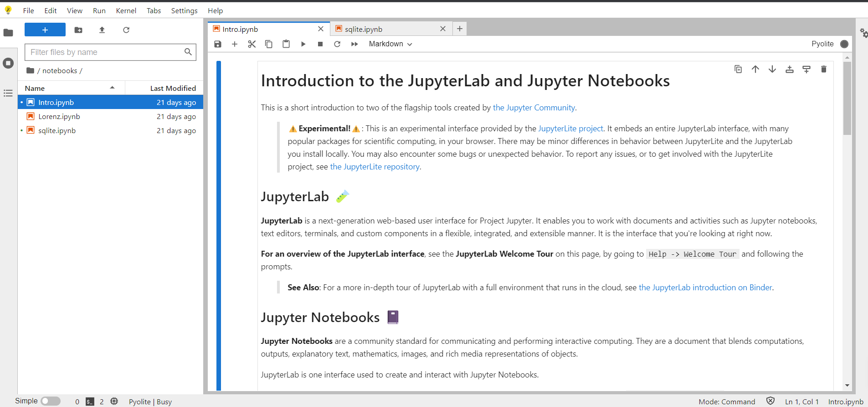
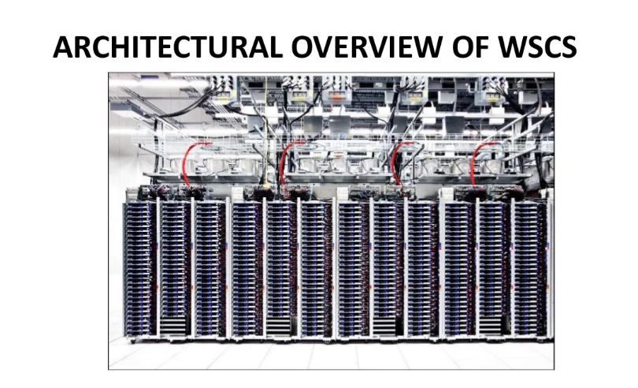
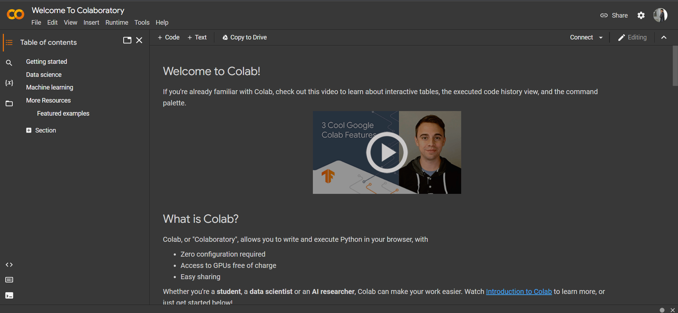

Slide 6
WSC Uses
cost-performance - work done per dollar
energy efficiency - work done per joule
Durability via redundancy network I/O
interactive and batch processing workload

Slide 7
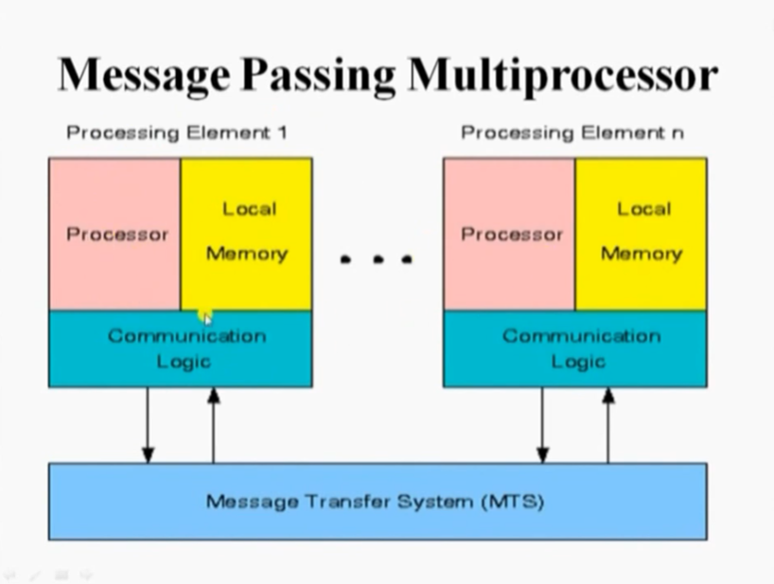
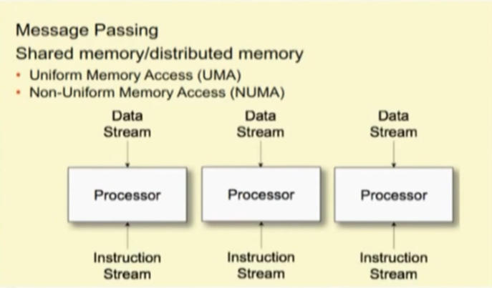
Message Passing Multi Processor

Slide 8
Message Passing Multi Processor
It Provide Alternative Methods for Communication and Movement of data Among Multi Processors
A Message Passing System Typically Combines Local Memory and Processor at each Noce of the Interconnection Network
It Consists of Multiple computers Called Nodes Interconnected by Message Passing Network
Each Node acts as an Autonomous Computer having a Processor a, ac Local Memory and Sometimes I/O devices
Memory Access
UMA - Uniform Memory Access
NUMA - Non Uniform Memory Access
COMA - Cache Only Memory Access

Slide 9
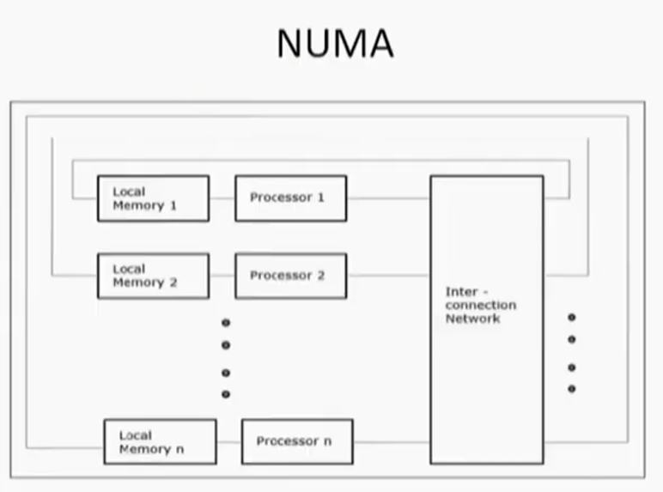
NUMA

Slide 10
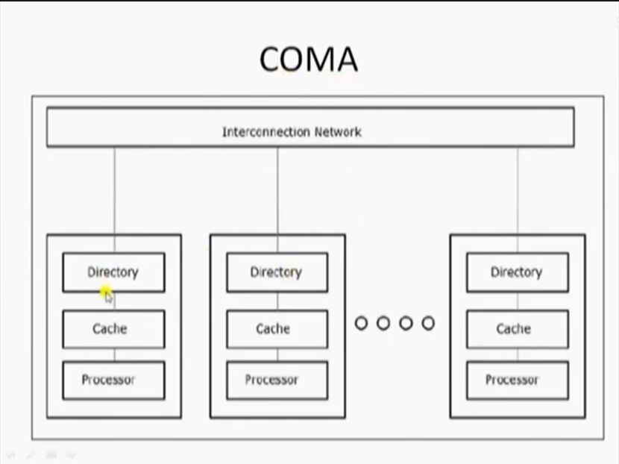
COMA

Slide 11
Thank You

